Slide 1
Project C.A.S.P.
Week 11, 4/17/17
Ryan Tedeschi
Dylan Carson

Slide 2
Weekly Progress
Translate Module Completed
Both Core & Standalone Implementations
Print Module added to Standalone Application
Cleanup
Parse Tree issues fixed
i.e. Where it recognized terminals, but failed to recognize the containing productions
Analyze module

Slide 3
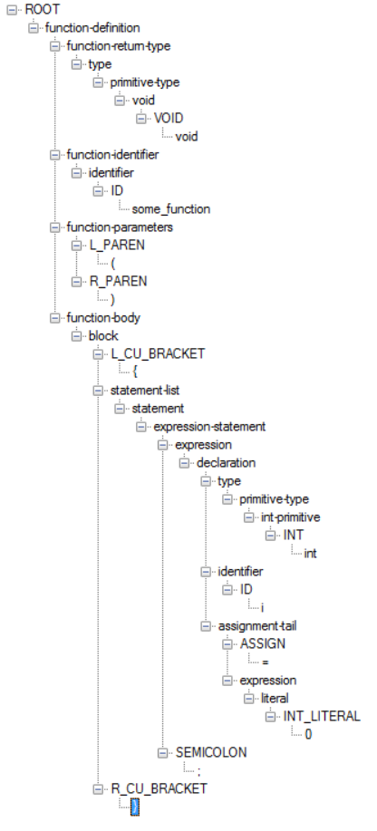

Print Module: Standalone Implementation
Generated From the following code
Simply prints out the parse tree in an easily navigable form
Features collapsible nodes to more easily focus on a particular subtree

Slide 4
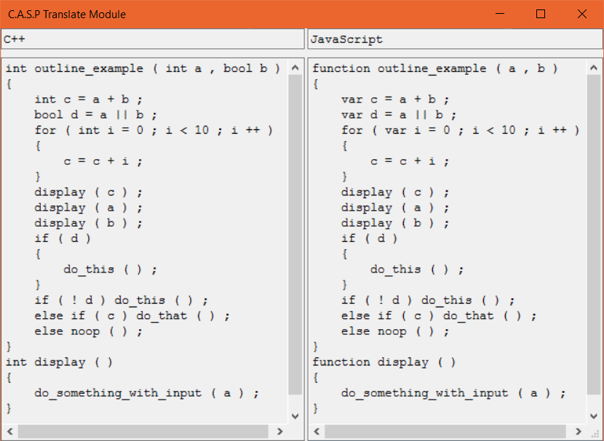
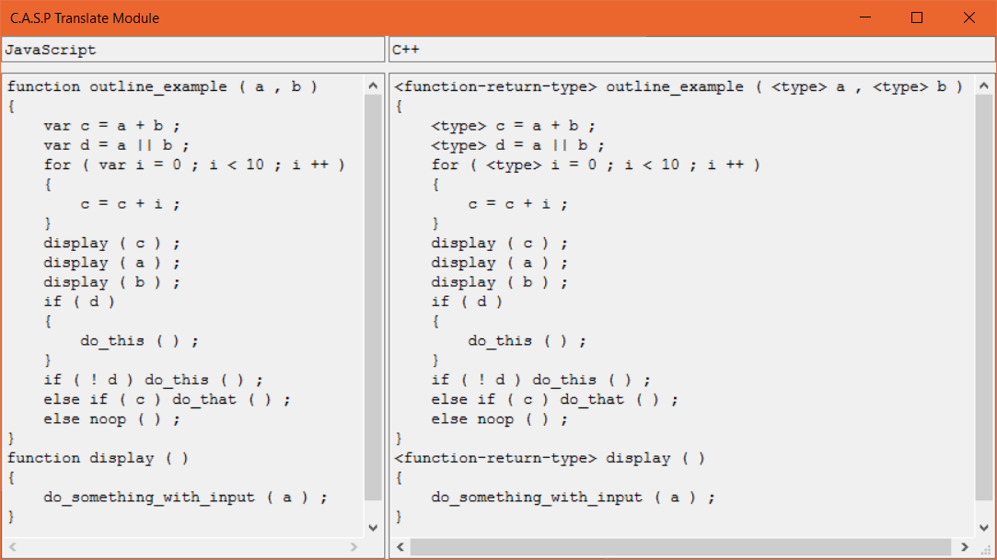
Translate Module: Visual Example
More to Less specific, good translation
Less to More specific, failed translation

Slide 5
Weekly Tasks
Collective Tasks
Complete Analyze Module
Cleanup
Error Handling
Documentation

